Slide 1
SVN - Apache Subversion
1 November 2021

Slide 2
Agenda
Version Control System Types of Version Control Systems
Distributed Version Control System
What is TortoiseSVN
Features of TortoiseSVN
Tortoise SVN Installation
How Subversion works
Importing a Project
Tortoise GUI
Tortoise overview
Icon Overlays
Making Changes
Repository Browser
Viewing the Project History
Undoing Changes
Checking Out A Working Copy
Committing Changes To The Repository
Conflicts

Slide 3
Version Control System
Version control is a system that records changes to a file or set of files.
The following are the types of version control systems:
Local Version Control System (Ex) RCS
Centralized Version Control System (Ex) CVS, Subversion, Perforce
Distributed Version Control System (Ex) Git , Mercurial, Bazaar or Darcs

Slide 4
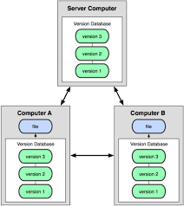
Distributed Version Control System
Distributed version control system(DVCS) keeps track of software revisions and allows many developers to work on a given project without maintaining a connection to a common network.
Example: SVN, Git

Slide 5
What is TortoiseSVN
Subversion and version control systems = “time machine”
Tortoise SVN is a free open-source Windows client for the Apache™ Subversion® version control system
It manages files and directories over time
Files are stored in a central repository.
It is much like an ordinary file server, except that it remembers every change ever made to all files and directories.
Allows user to recover older versions of files and examine the history of how and when was data changed, and who changed it.

Slide 6
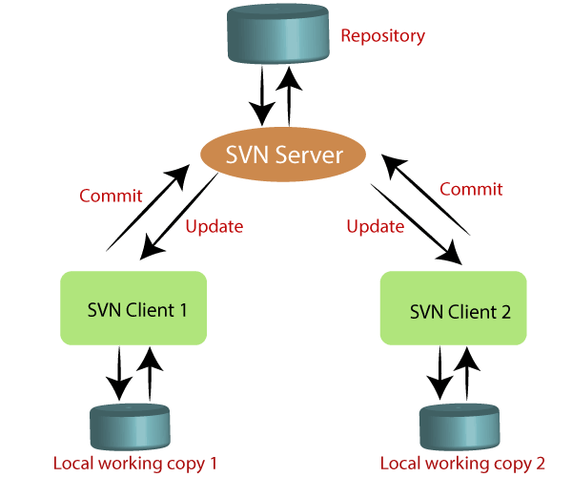
Components of SVN
There are two core components of SVN; they are as follows:
SVN server
SVN client

Slide 7
Features of TortoiseSVN
Shell integration
Icon overlays
Graphical User Interface
Easy access to Subversion commands

Slide 8
Features of Subversion
Directory versioning
Atomic commits
Versioned metadata
Choice of network layers
Consistent data handling
Efficient branching and tagging

Slide 9
Tortoise SVN Installation
Free Open-Source tool
Runs on Windows Vista or higher and is available in both 32-bit and 64-bit systems
How to Install:-
Download the installer file from “https://tortoisesvn.net/downloads.html”
Double click and install using the installer downloaded.
Reboot the system before using it

Slide 10
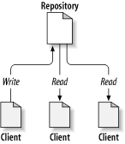
How Subversion works
The Repository
Subversion uses a central database which is the repository.
It contains all your version-controlled files with their complete history

Slide 11
How Subversion works (contd.,)
Working Copy
Every developer has his own working copy, called as a sandbox, on his local PC.
One can pull down the latest version from the repository, work on it locally without affecting anyone else, and commit them back to the repository after working on it.

Slide 12
How Subversion works (contd.,)
The Copy-Modify-Merge Model Solution by default
In this model, each user's client reads the repository and creates a personal working copy of the file or project.
Users then work in parallel, modifying their private copies. Finally, the private copies are merged together into a new, final version.
The version control system often assists with the merging, but ultimately a human being is responsible for making it happen correctly.
However, as of Version 1.2, Subversion also supports file locking, so if you have unmergeable files, or if you are simply forced into a locking policy by management, Subversion will still provide the features you need.

Slide 13
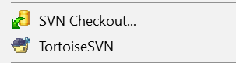
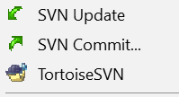
Importing a Project
For a real project you will have a repository set up somewhere safe and a Subversion server to control it.
For Example:
Create a new folder and name it as per the project requirement /workspace (example: svn_demo)
Inside the svn_demo directory, right click and select SVN Checkout…
Once you have the checkout done, later you can either update/commit

Slide 14
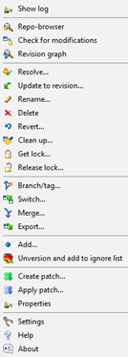
Tortoise GUI
•Repository Browser - Browse the repository tree
•Show diff - Shows file diff. between WC and repository
•Check for modification - Check for local modifications
•Revert - Reverts local changes back to revision
•Get lock/Release Lock - For unmergeble files. Unlocked automatically at commit
•Help - to get help for cmd line and tortoise
•Add – Marks new files for addition to the repository on next commit
•Delete – Removes the file from the WC immediately as well as marks them for deletion in the repository on next commit

Slide 15
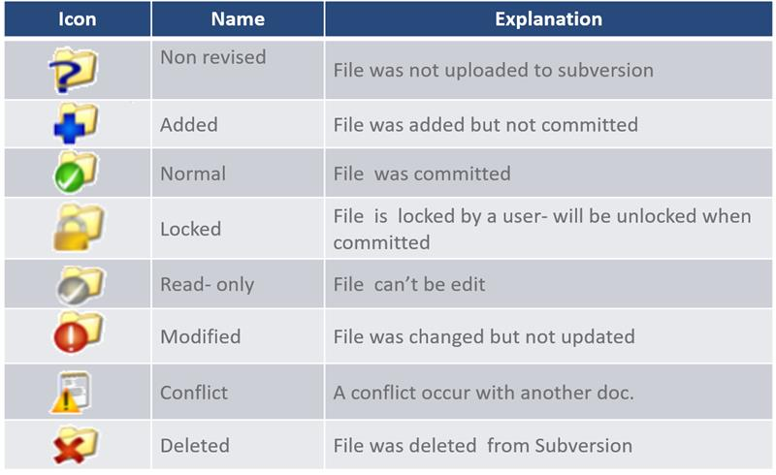
Tortoise Overview

Slide 16
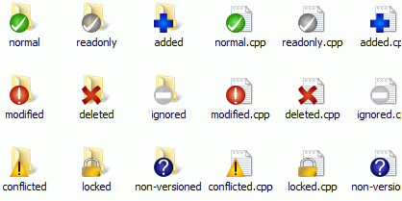
Icon Overlays
While you are working on your working copy we often need to know which files we have changed / added / removed or renamed, or even which files got changed and committed by others.

Slide 17
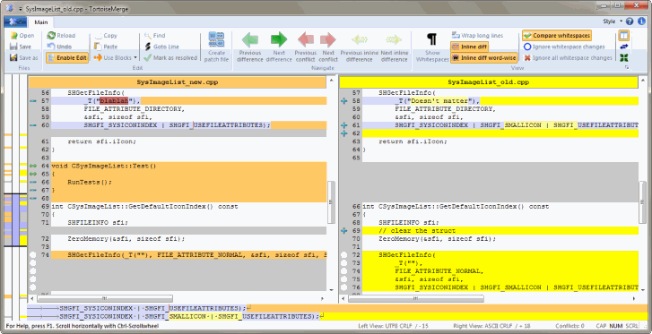
Making Changes
File Difference Viewer -> “TortoiseSVN → Diff”

Slide 18
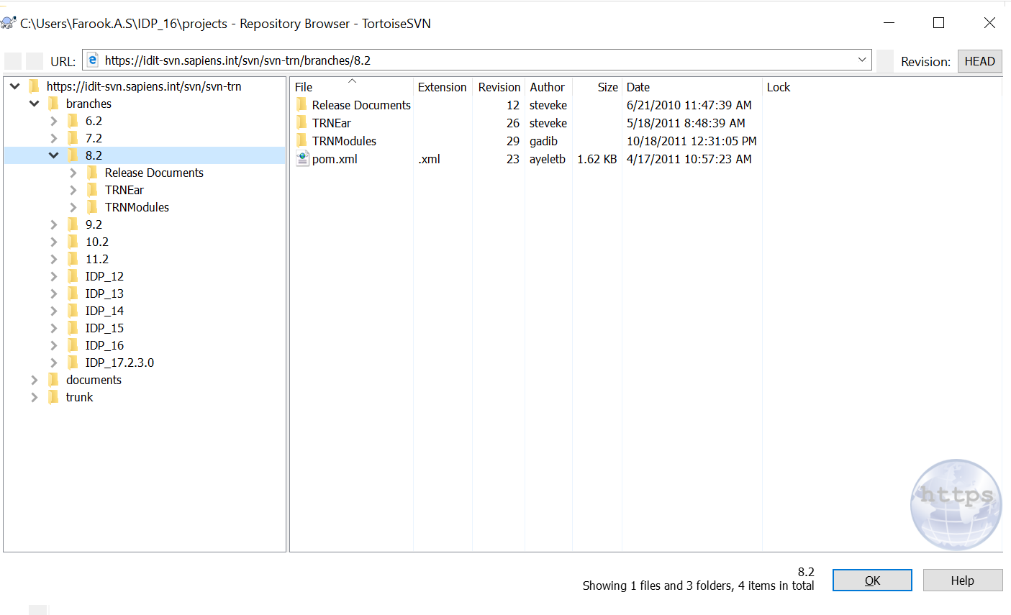
Repository Browser

Slide 19
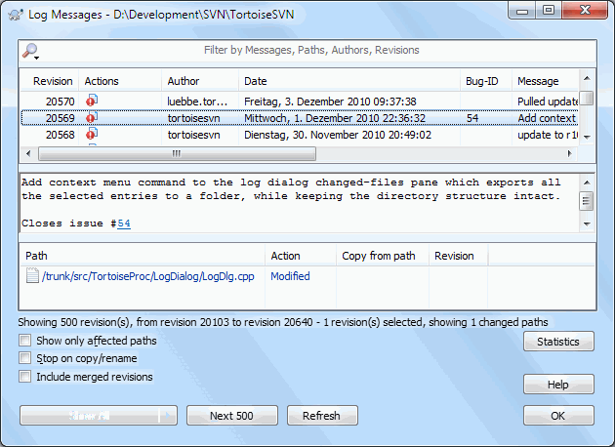
Viewing the Project History
The Log dialog
Displays list of all the commits you made to a file or folder, and shows those detailed commit messages that you entered

Slide 20
Undoing Changes
Feature to undo changes that was made previously
To get rid of changes that you have not yet committed and reset your file to the way it was before you started editing
Command
TortoiseSVN → Revert

Slide 21
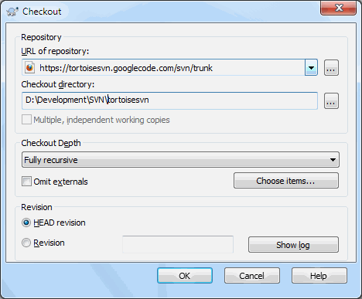
Checking Out A Working Copy
Working copy needs to be checkout from a repository.
In the explorer wherever we need the working copy, Right click to pop up the context menu and select the command
TortoiseSVN → Checkout

Slide 22
Checking Out A Working Copy
Checkout Depth
Fully recursive - Checkout the entire tree, including all child folders and sub-folders.
Immediate children, including folders -Checkout the specified directory, including all files and child folders, but do not populate the child folders.
Only file children - Checkout the specified directory, including all files but do not checkout any child folders
Only this item - Checkout the directory only. Do not populate it with files or child folders.
Working copy - Retain the depth specified in the working copy.
Exclude - Used to reduce working copy depth after a folder has already been populated. This option is only available in the Update to revision dialog.

Slide 23
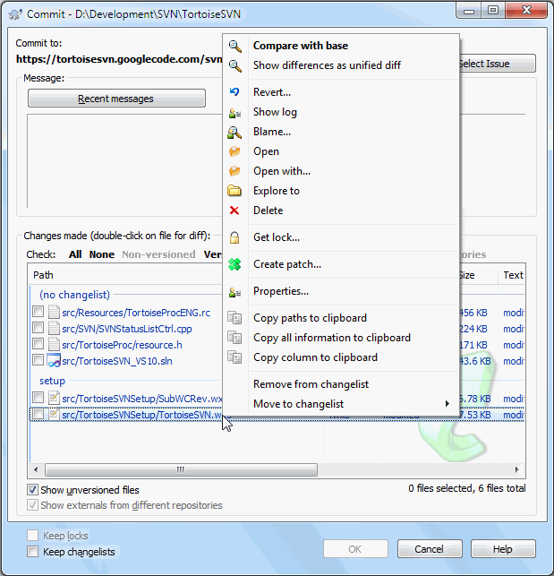
Committing Changes To The Repository
The Commit Dialog - TortoiseSVN → Commit....
Once working copy is up to date and there are no conflicts, coming using TortoiseSVN → Commit

Slide 24
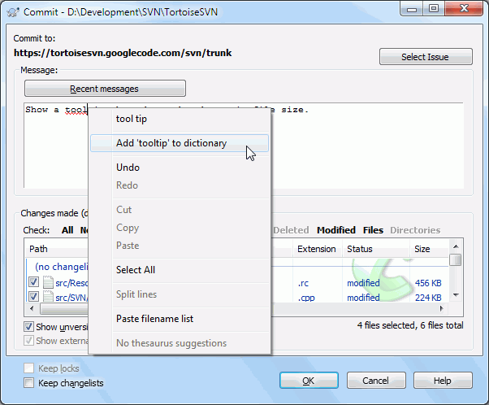
Committing Changes To The Repository
Commit Log Messages
Description on changes committed
Help, as you browse through the project to see what happened and when we hot copy go through the log messages at a later date.

Slide 25
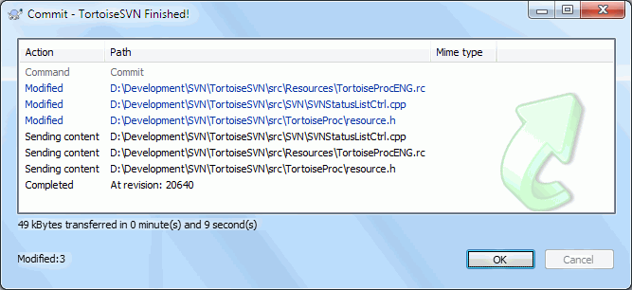
Committing Changes To The Repository
Commit Progress
After pressing OK, a dialog appears displaying the progress of the commit.
Blue - Committing a modification
Purple - Committing a new addition
Dark red - Committing a deletion or a replacement
Black - All other items

Slide 26
Conflicts

Slide 27
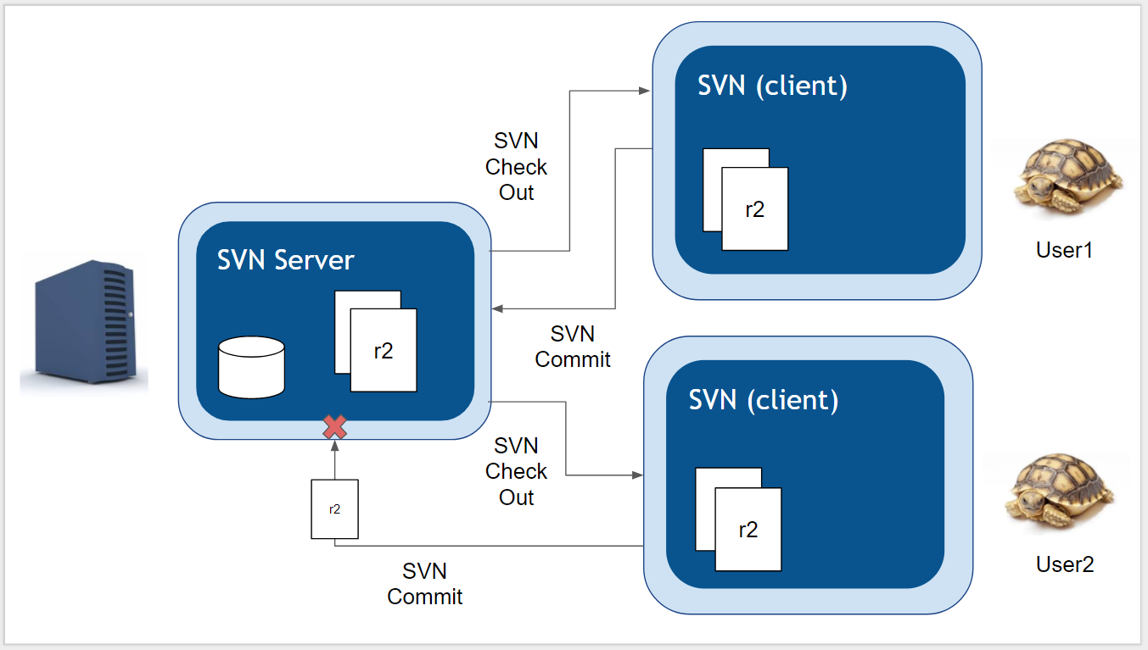
A Conflict Scenario

Slide 28
A Conflict Scenario (contd.,)
Two users have checked out the contents of the repository to their local machines both users start editing one of the files on the local machines (just so happens that they are both editing the same file)
The first user commits his/her changes to the repository
The second user tries to commit his/her changes to the repository too
Trouble is the second user changes would overwrite the first user changes (so the first user changes would be lost)
SVN warns user 2 that there is a conflict It’s down to user 2 to resolve that conflict

Slide 29
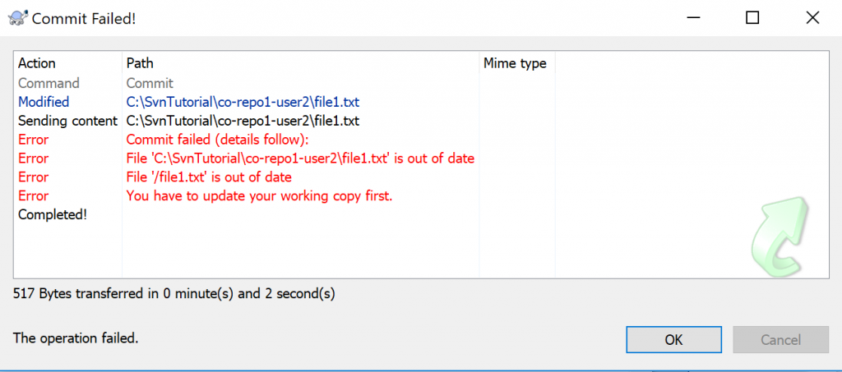
SVN Warning message
SVN Warning message for Conflict

Slide 30
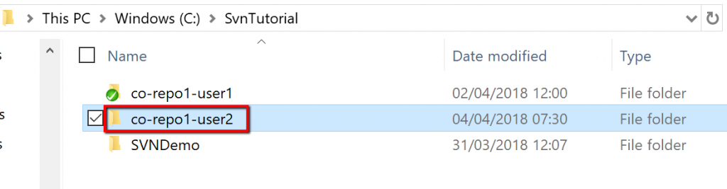
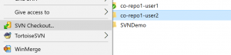
How to resolve Conflict
User 1 to Create a new directory (a 2nd directory) where User 2 will check their files out to
Create a new directory (a 2nd directory) where User 2 will check their files out to
Check out the contents of the repository to this directory using TortoiseSVN Checkout command

Slide 31
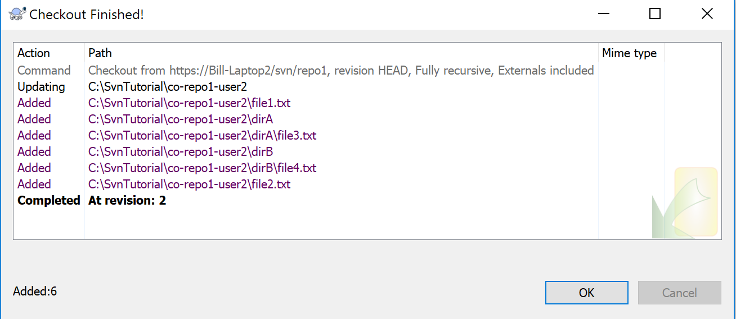
How to resolve Conflict (contd.,)
User 1 Checkout competed

Slide 32
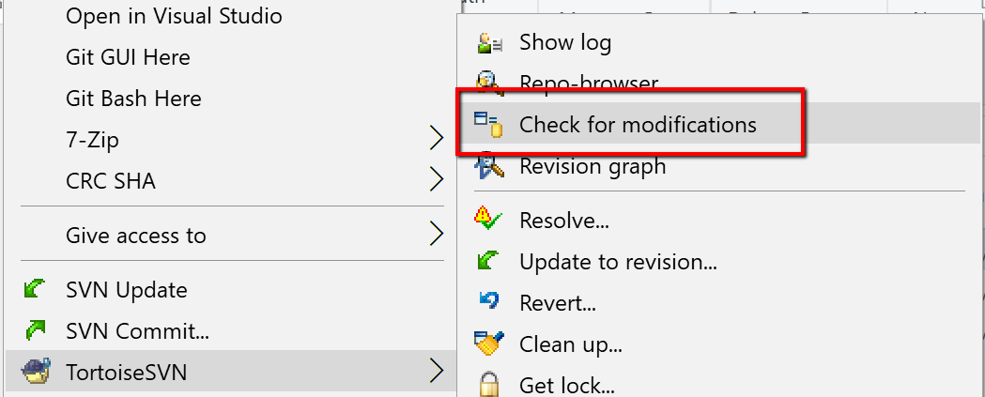
How to resolve Conflict (contd.,)
Check for modifications
Both directories now contain the contents of the repository and both are in sync with the latest updates that have been committed to the repository. We will check this with “Check for Modifications”

Slide 33
How to resolve Conflict – Simulating Conflict
Steps to Simulating the Conflict
Modify a file in the first (user 1) directory
Commit the modified file in the first directory to the repository
Modify a file in the second (user 2) directory
Attempt to commit the modified file in the second directory to the repository
Deal with the conflict

Slide 34
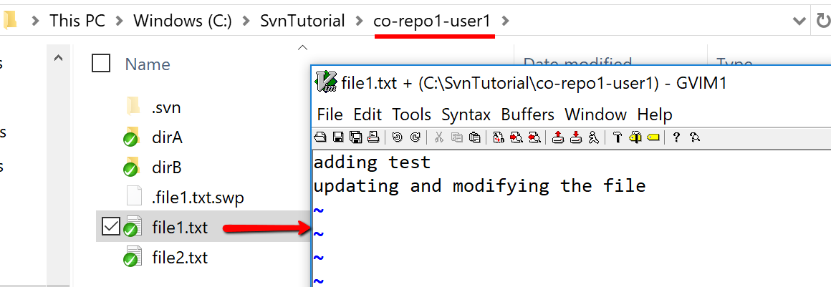
Simulating the Conflict
Step 1: modify a file in the first (user 1) directory
So first, update one of the text files in the first directory and save your changes (you can use notepad or any text editor of your choice).

Slide 35
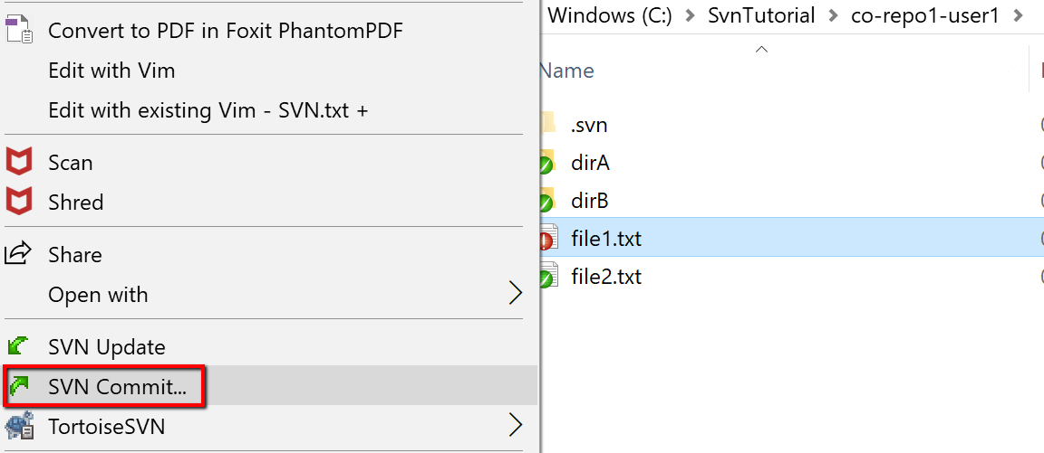
Simulating the Conflict (contd.,)
Step 2: Commit the modified file in the first directory to the repository
Then commit these changes to the repository
Note that you are committing changes from Users 2’s directory to the same central repository.

Slide 36
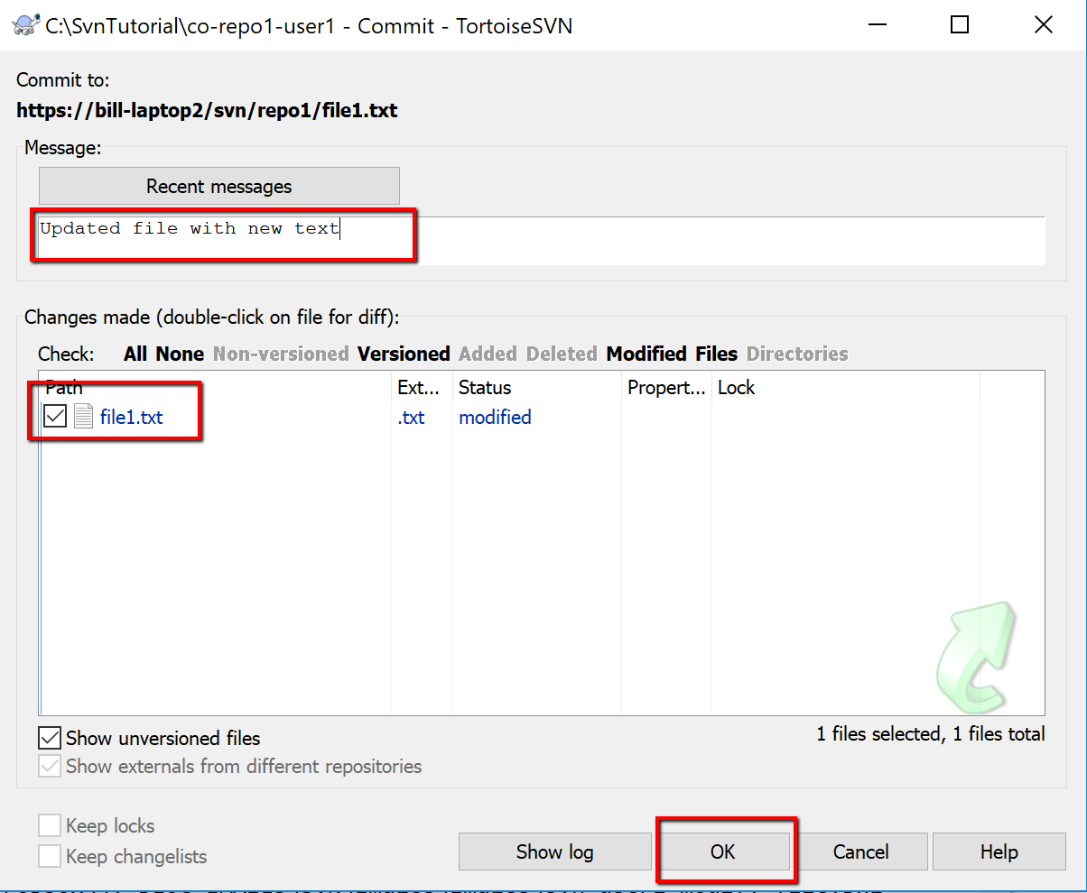
Simulating the Conflict (contd.,)
Step 2: Commit the modified file in the first directory to the repository(Contd.,)
Adding a comment and clicking okay to complete the commit.

Slide 37
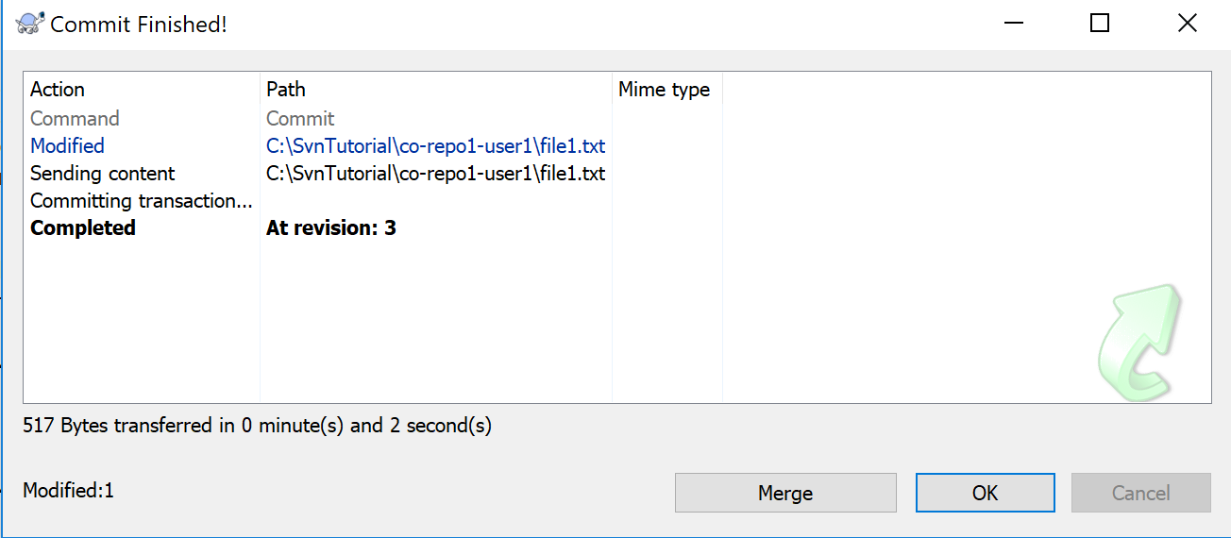
Simulating the Conflict (contd.,)
Step 2: Commit the modified file in the first directory to the repository(Contd.,)
Check for the successful commit message and note the new revision number… then click OK.

Slide 38
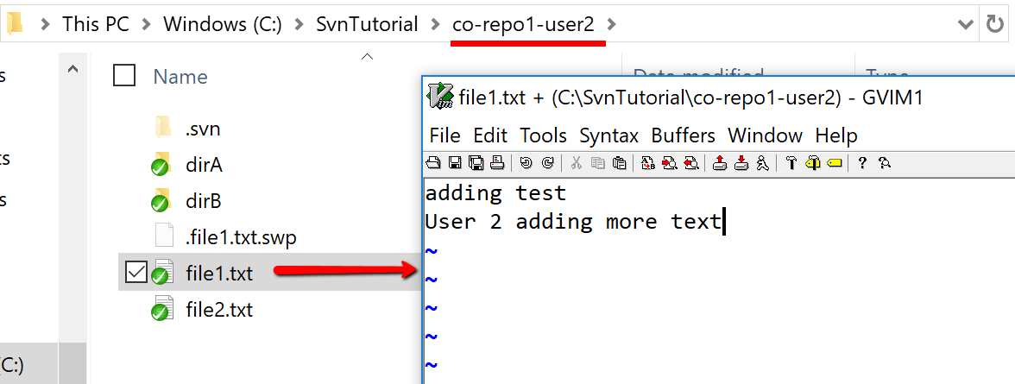
Simulating the Conflict
Step 3: Modify a file in the second (user 2) directory(Step 1 repeated for User 2)
Update one of the text files in the second directory and save the changes.

Slide 39
Simulating the Conflict (contd.,)
Step 4: Attempt to commit the modified file in the second directory to the repository
Then commit these changes to the repository

Slide 40
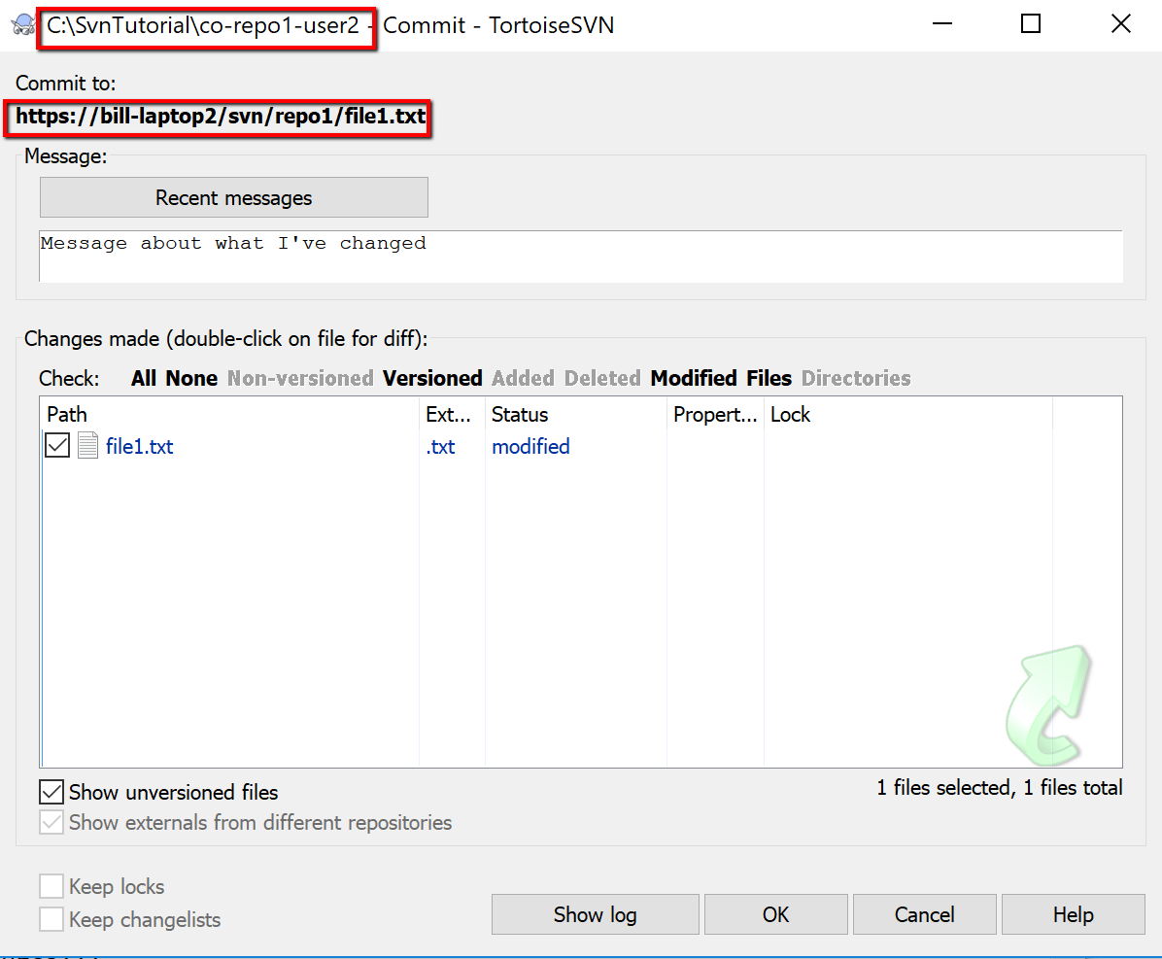
Simulating the Conflict (contd.,)
Step 4: Attempt to commit the modified file in the second directory to the repository(contd.,)
Committing changes from Users 2’s directory to the same central repository.

Slide 41
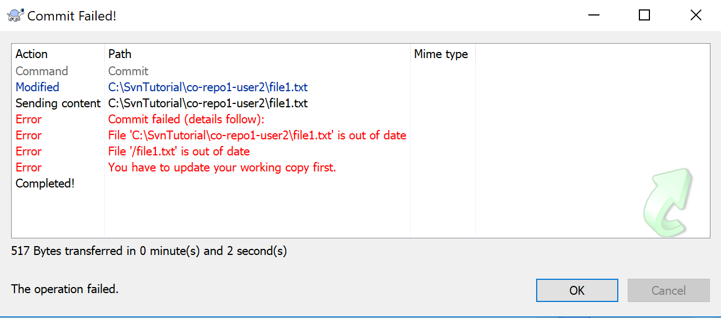
Simulating the Conflict (contd.,)
Step 4: Attempt to commit the modified file in the second directory to the repository(contd.,)
When committed, warning message is displayed

Slide 42
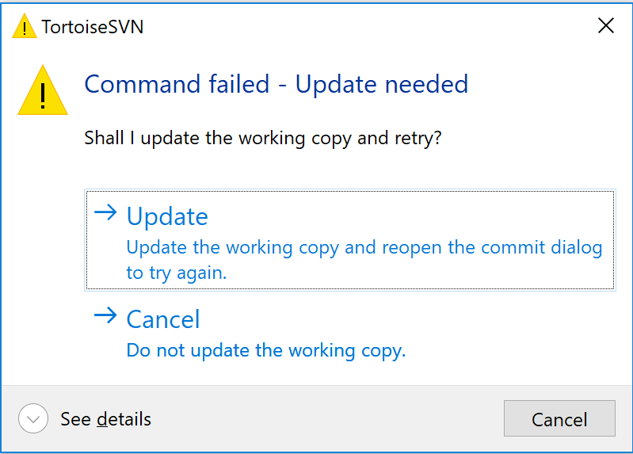
Simulating the Conflict (contd.,)
Step 5: Deal with the conflict
When committed is completed, user is presented with a warning message.
SVN is warning users that the version of file1.txt that we updated was not done to the latest version of the file that was in the repository. If we commit this change then the latest version of the file in the repository will be overwritten and changes lost.
We need to resolve this conflict first. Without a resolution, SVN won’t let us commit this change to the repository. So click OK to clear the ‘Commit Failed’ warning dialogue box. And at this point SVN will ask you if you want to update your local working copy.

Slide 43
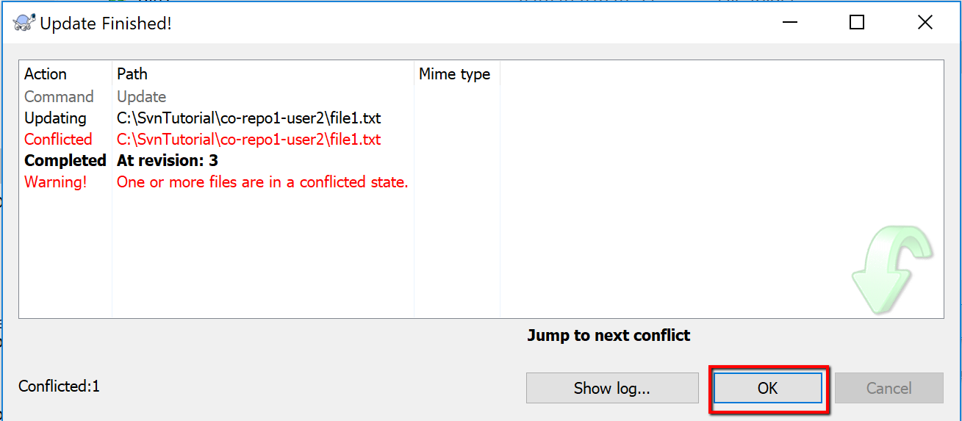
Simulating the Conflict (contd.,)
Step 5: Deal with the conflict
When presented with the update finished message, this can be cleared by clicking the okay button…

Slide 44
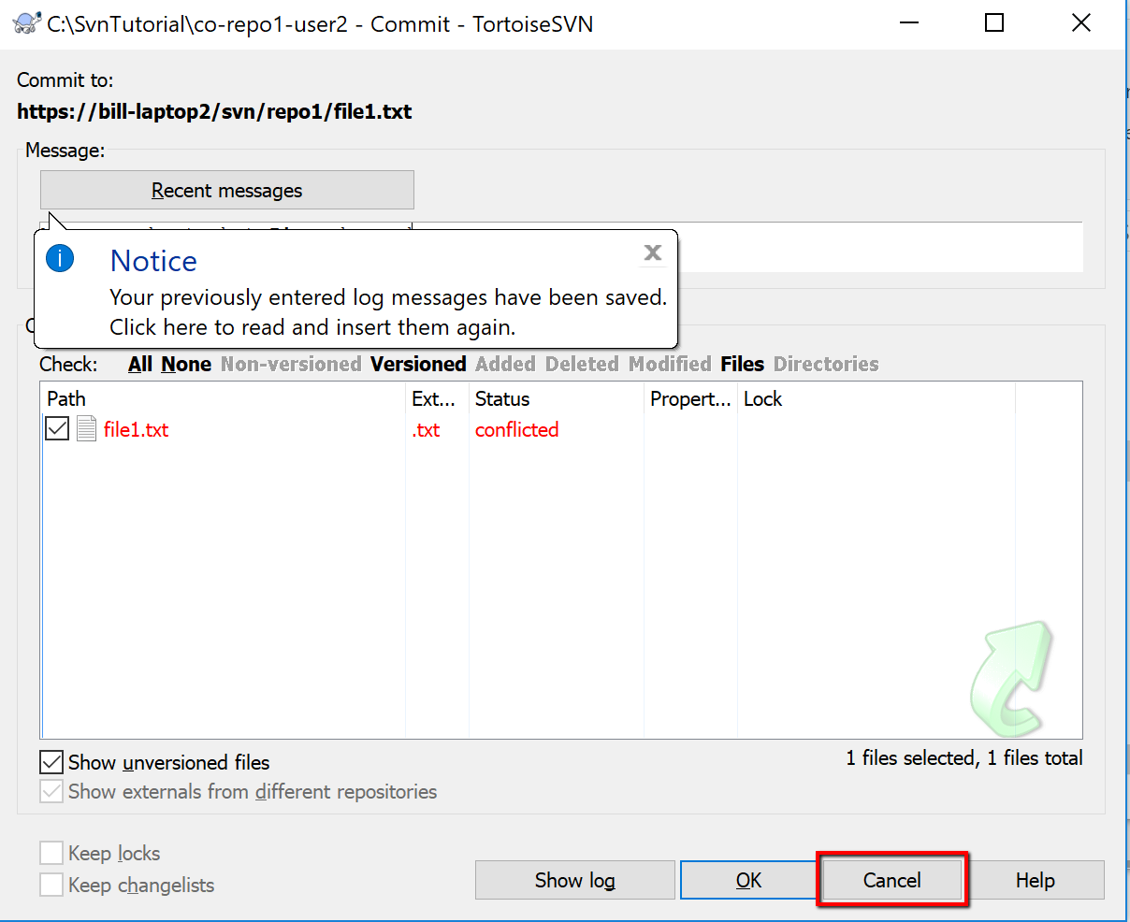
Simulating the Conflict (contd.,)
Step 5: Deal with the conflict
And then on the next dialogue box (that gives the option to commit your changes again) click ‘Cancel’.

Slide 45
Simulating the Conflict (contd.,)
Step 5: Deal with the conflict
And then on the next dialogue box (that gives the option to commit your changes again) click ‘Cancel’.

Slide 46
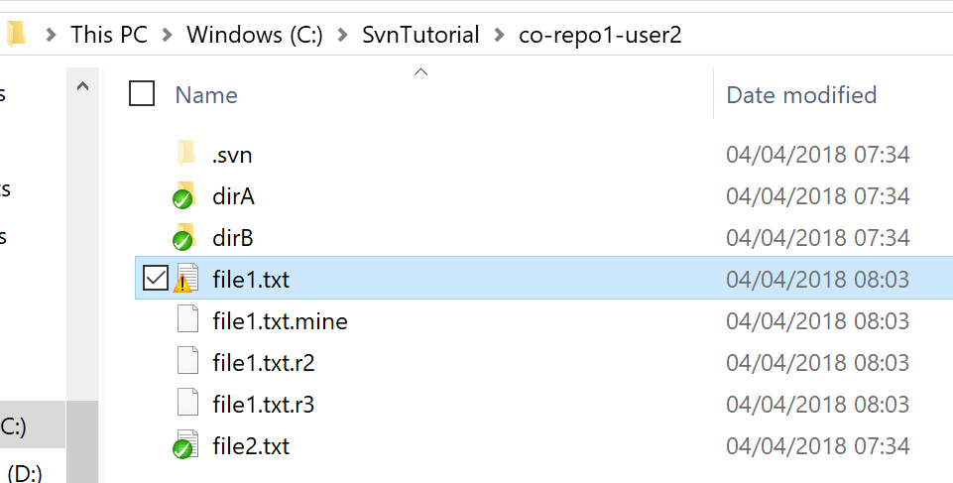
Simulating the Conflict (contd.,)
Step 5: Deal with the conflict
Now we can find not 1, but 4 copies of the file you were working on. Those 4 files are
file1.txt: File where SVN has tried to combine both the latest version from the repository
file1.txt.mine: Local version with latest changes.
file1.txt.r2: Originally checked out of the repository (before local changes were made)
file1.txt.r3: Latest version of the file from the repository with all the latest updates that have been committed by other users.

Slide 47

Conflict resolution
Use a diff/merge tool to compare file1.txt.mine and file1.txt.r3
Merge the changes between file1.txt.mine and file1.txt.r3 (with a tool like winMerge)
Copy the resulting file (or rename it) to file1.txt (overwriting the svn merge file)
Resolve the conflict
Commit the change back to the repository

Slide 48
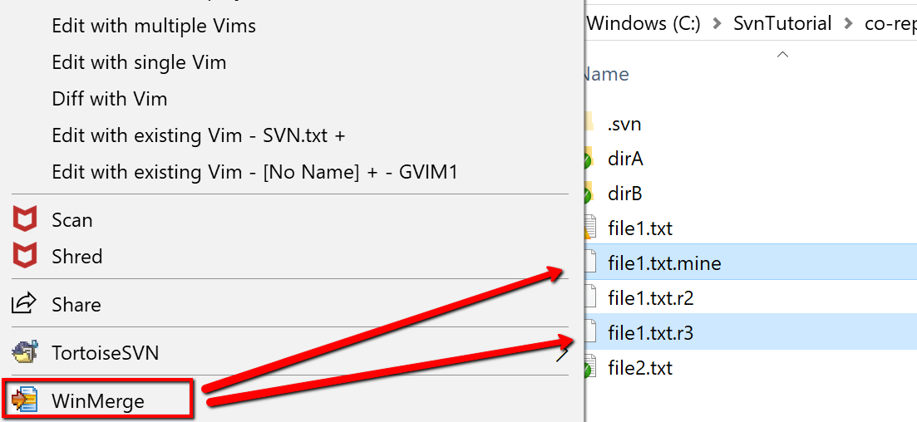
Conflict resolution
Step 1: Use a diff/merge tool to compare files
Use a diff/merge tool to compare file1.txt.mine and file1.txt.r3

Slide 49
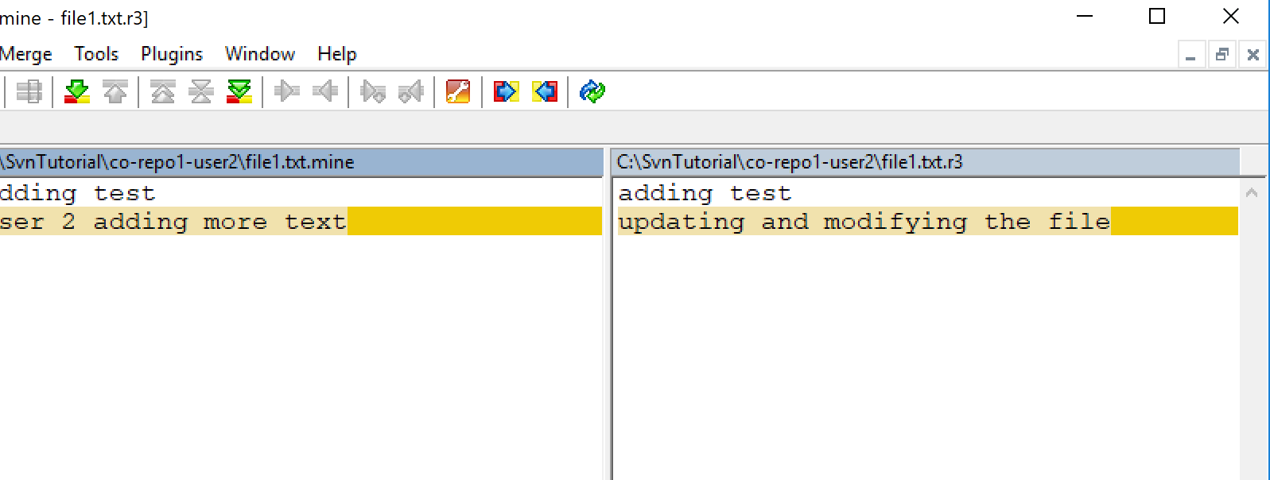
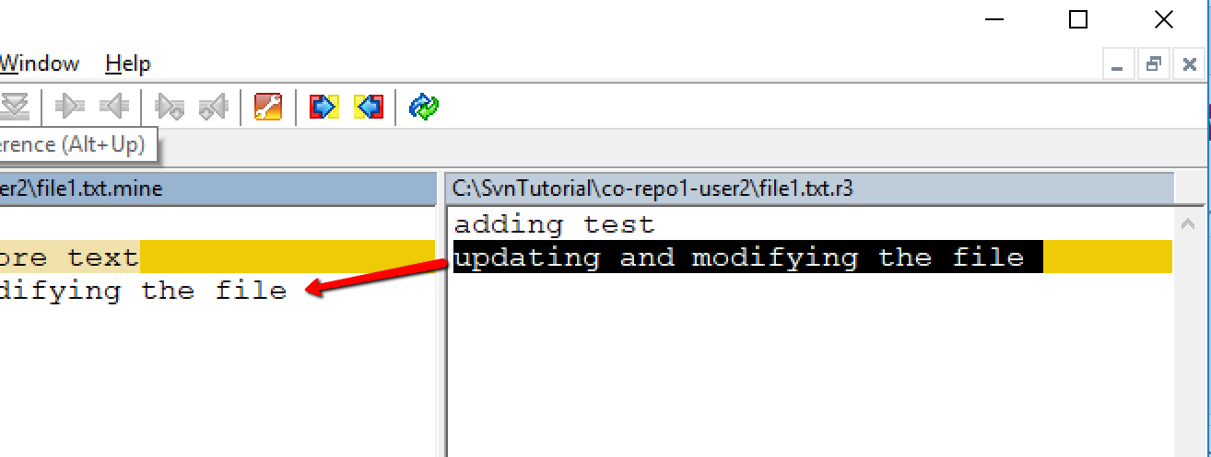
Conflict resolution
Step 2: Merge the changes
Merge the changes between file1.txt.mine and file1.txt.r3 (with a tool like winMerge)
Local version and changes are on the left. And on the right the latest version of the file from the repository. We’ll merge the repository changes into our local version. So we’ll merge right to left.

Slide 50
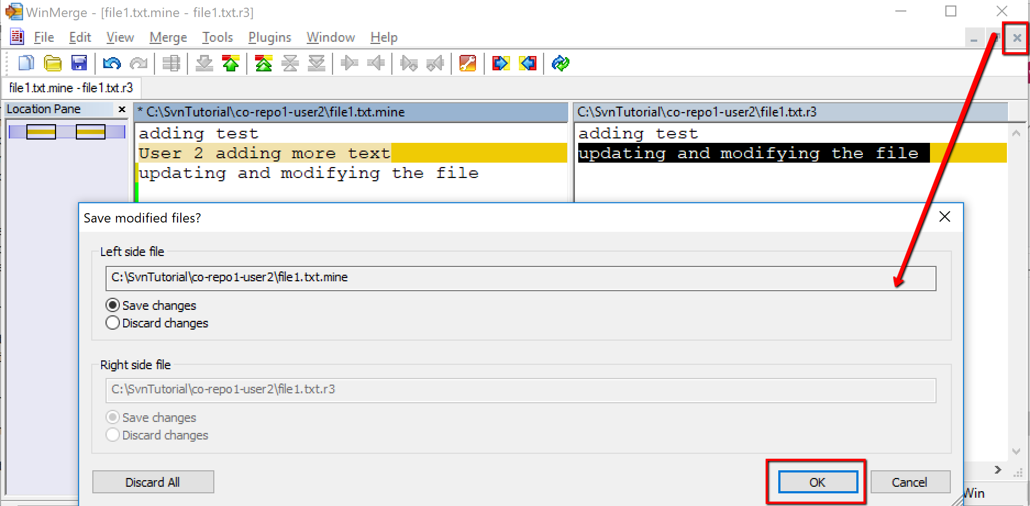
Conflict resolution
Step 2: Merge the changes (contd.,)
Save the file and close the merge tool.

Slide 51
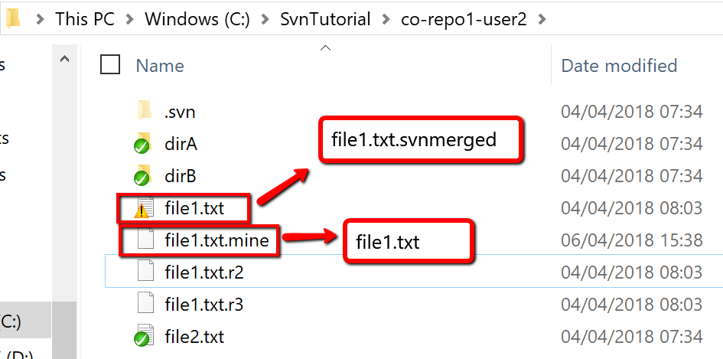
Conflict resolution
Step 3: Copy the resulting file
File with all the changes the one called file1.txt. So, rename file1.txt to file1.txt.Svnmerged. Then rename file1.txt.mine to file1.txt.

Slide 52
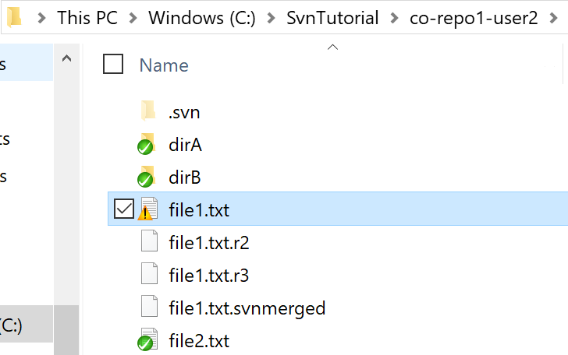
Conflict resolution
Step 3: Copy the resulting file (contd.,)
All our changes (the merged changes) are in the file file1.txt.
The newly merged file1.txt should still show the SVN conflict warning triangle.

Slide 53
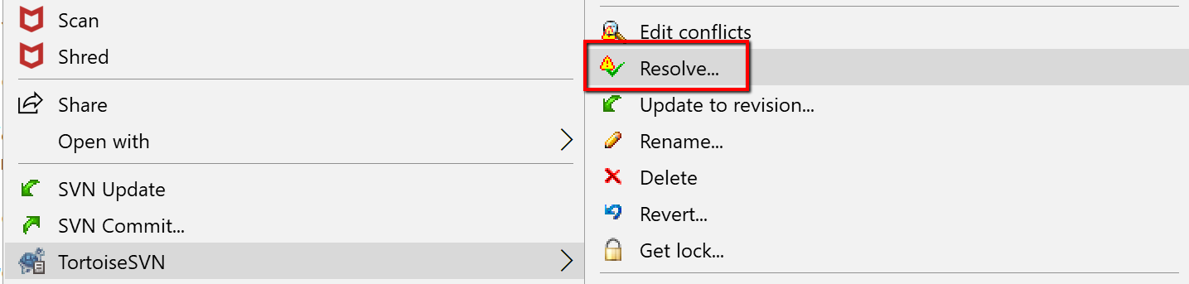
Conflict resolution
Step 4: Resolve the conflict
We want to tell SVN that we’ve resolved the conflict.
Right click on the file and select ‘Resolve’.

Slide 54
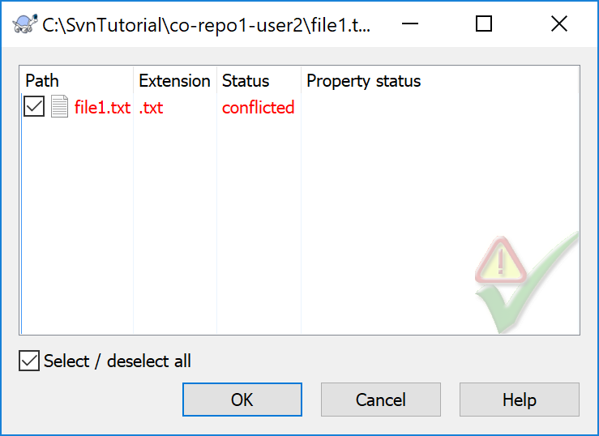
Conflict resolution
Step 4: Resolve the conflict (contd.,)
In the conflict resolution dialogue box displayed, click okay to confirm the resolution.
Then click OK to the last confirmation dialogue box.

Slide 55
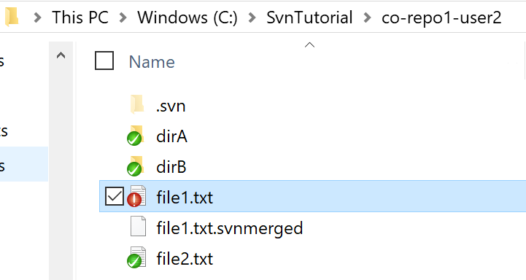
Conflict resolution
Step 5: Commit the change back to the repository
At which point we should be back to one of our usual states where SVN is just telling us that we have updated our local file and that it’s ready to be committed to the repository.

Slide 56
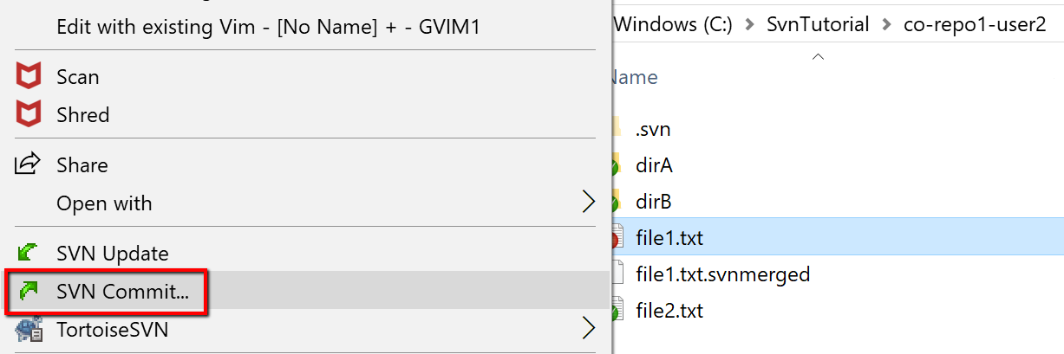
Conflict resolution
Step 5: Commit the change back to the repository (contd.,)
Commit the file back to the repository.

Slide 57
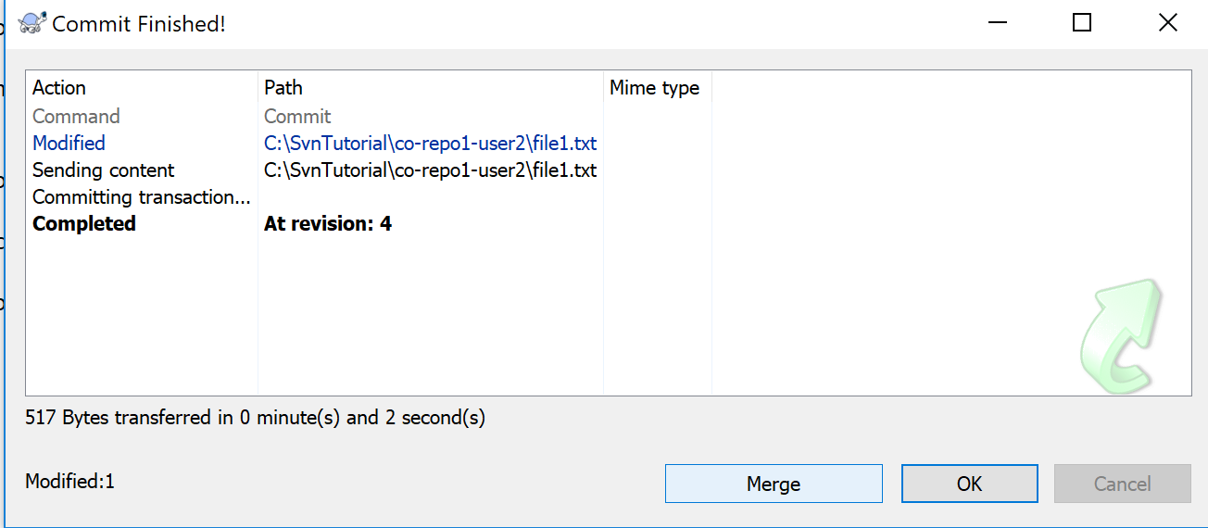
Conflict resolution
Step 5: Commit the change back to the repository (contd.,)
Complete the commit and we should now have the latest revision of the file (revision 4 in this case) stored in the repository with the merged changes from both user 1 and user 2.

Slide 58
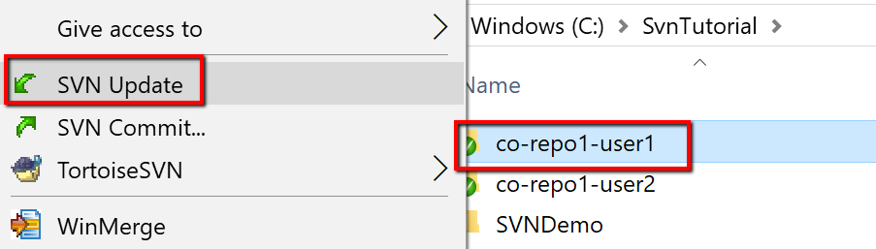
Conflict resolution
Step 5: Commit the change back to the repository (contd.,)
At this point, we’ve completed the merge and everything is straight.
User 2 has the latest copy of the merged changes (revision 3).
User 1 is still in revision 3. So a good last step for User 1 is to update the local copy of the files.
So user 1 (in the directory ../co-repo1-user1) should update their local copy by right-clicking and selecting ‘SVN Update’.

Slide 59
Conflict resolution
Step 5: Commit the change back to the repository (contd.,)
With the last update, everybody is in sync with the latest merged version of the files from the repository.
And we’ve seen 2 users successfully collaborate and version control the same file on multiple client machines without losing anybody updates to the files.

Slide 60



